Slide 1
Bluestock MF Capstone Project
Mutual Fund Data Analysis - ETL, EDA, and Power BI Dashboard
Anil Kankala

Slide 2
Problem & Objective
Mutual fund data is scattered across multiple raw sources (fund details, NAV history, transactions, performance)
Objective: build an end-to-end pipeline to clean, structure, and analyze this data
Deliver an interactive dashboard for exploring fund performance, investor behavior, and market trends

Slide 3
Data Sources
10 raw CSV datasets: fund master, NAV history, AUM by fund house, SIP inflows, category inflows, folio counts, scheme performance, investor transactions, portfolio holdings, benchmark indices
Live NAV data fetched from the mfapi.in public API
Covers 40 mutual fund schemes across 10 fund houses, 2022-2025

Slide 4
Architecture
Raw CSVs -> Python (pandas) cleaning and validation
Cleaned data loaded into a SQLite star schema (dim_fund, dim_date, and 4 fact tables)
Exploratory analysis in Jupyter (matplotlib, seaborn, plotly)
Interactive dashboard built in Power BI, connected to the cleaned data

Slide 5
EDA Highlights - NAV & AUM Trends
Daily NAV tracked for all 40 schemes across 2022-2025
AUM growth analyzed by fund house year over year
Industry AUM grew steadily from roughly Rs 3M Cr in 2022 to over Rs 6M Cr by 2025, with SBI Mutual Fund holding the largest share among all 10 fund houses, followed by ICICI Prudential and HDFC

Slide 6
EDA Highlights - Investors & Sectors
Investor demographics analyzed by age group, gender, and geography
Sector allocation aggregated across equity fund holdings
Investors aged 26-35 contribute the highest average SIP amount of all age groups, with contributions declining steadily for older age brackets; Punjab, Tamil Nadu, and Madhya Pradesh lead in total transaction amount by state

Slide 7
Performance Metrics - Returns & Risk
Return vs risk analyzed across all 40 schemes (1yr, 3yr, 5yr returns)
Risk-adjusted metrics: Sharpe ratio, Sortino ratio, standard deviation
[Check your fund scorecard table (Page 2 of the dashboard) for the highest Sharpe ratio and lowest expense ratio funds - name the top 2-3 here]

Slide 8
Performance Metrics - Correlation
Pairwise NAV return correlation computed across 10 selected funds
Helps identify diversification opportunities within a portfolio
[Check your correlation heatmap in EDA_Analysis.ipynb - note which fund pairs are highly correlated (limited diversification benefit) vs weakly correlated (good for diversification)]

Slide 9
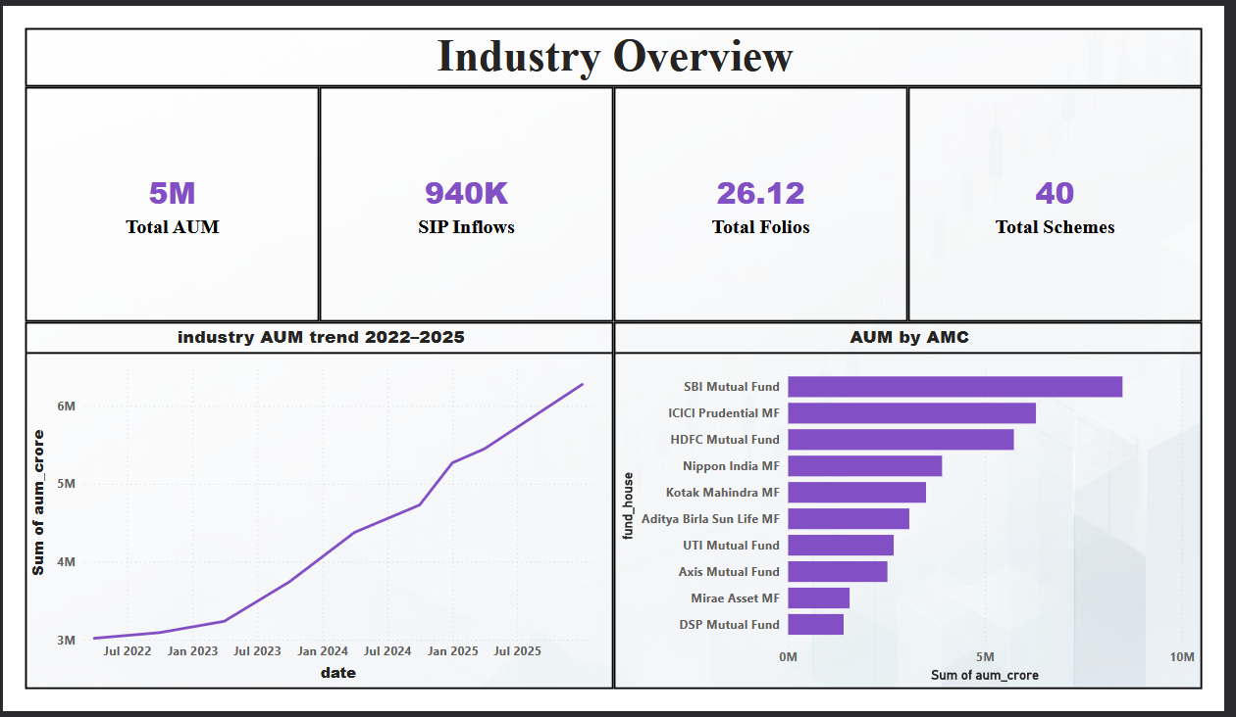
Dashboard - Industry Overview
Page 1: KPIs, AUM trend, AUM by AMC

Slide 10
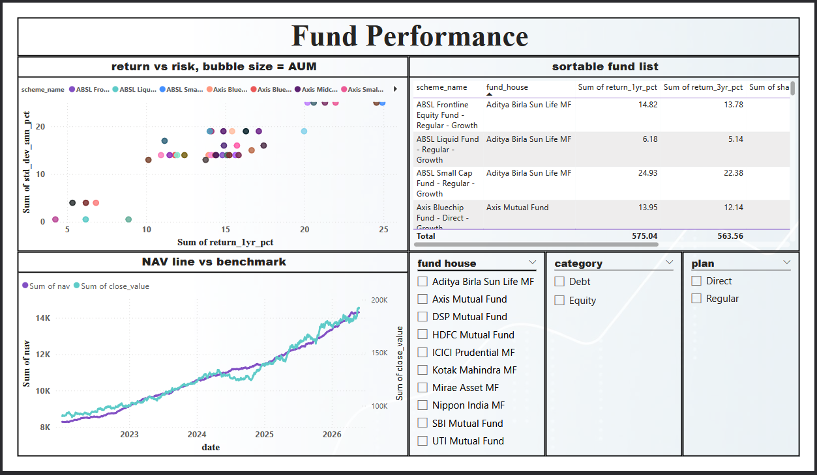
Dashboard - Fund Performance
Page 2: Return vs risk scatter, fund scorecard, NAV vs benchmark

Slide 11
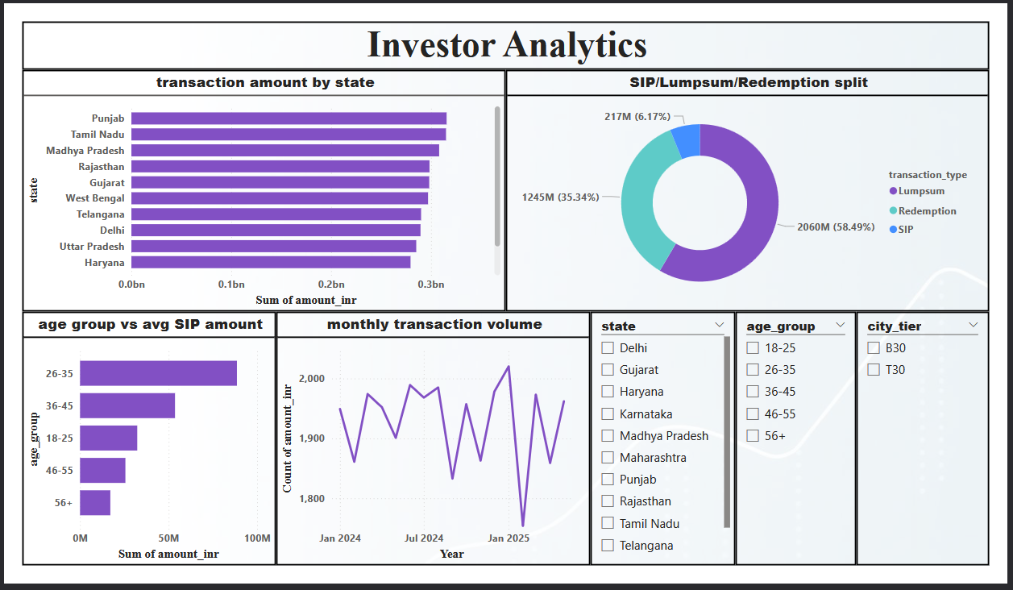
Dashboard - Investor Analytics

Slide 12
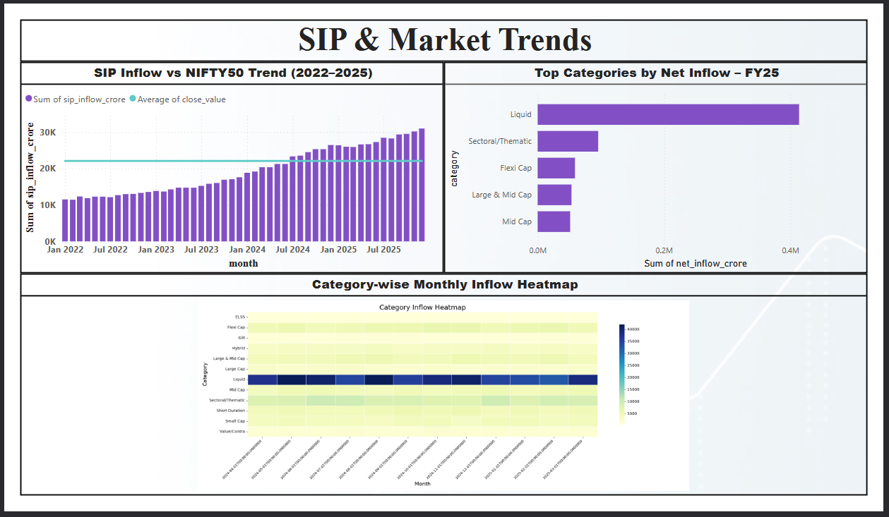
Dashboard - SIP & Market Trends

Slide 13
Key Findings
SBI Mutual Fund holds the largest AUM share among all 10 fund houses tracked
Industry AUM roughly doubled from Rs 3M Cr to over Rs 6M Cr between 2022 and 2025
Lumpsum investments make up the largest share of transaction value (58.5%), followed by Redemptions (35.3%), with SIP the smallest share (6.2%)
Investors aged 26-35 invest the highest average SIP amount, with contribution declining across older age groups
Punjab, Tamil Nadu, and Madhya Pradesh lead in total transaction amount by state, indicating strong regional concentration

Slide 14
Thank You
Questions?

